Slide 1
College Success Online
Dr. Marsha Fralick

Slide 2
Overview
Why teach online?
Are there some disadvantages?
What are some best practices?
Engaging students online
An overview of my class

Slide 3
PowerPoint and related documents posted online at:
http://www.collegesuccess1.com/spc.html

Slide 4

Online Education is Increasing
One third of all college students took an online course last year.
Online education grew 10% last year as compared to 2% for traditional education.
Online education grew 22% in community colleges.
Not enough online courses available to meet the demand.

Slide 5
Why teach online?
Think, Pair, Share

Slide 6
Why teach online?
Access
  Working students
  Veterans
  Parents
  Disabled
  Distance
Convenience
Opportunities provided by technology

Slide 7
Researcher Arthur Levine
Undergraduate education would be improved if:
78% Classes made greater use of technology
78% If professors made greater use of technology
52% If more blended courses were offered
33% If more courses were offered completely online

Slide 8
Are there some disadvantages of online education?
  Think
  Pair
  Share

Slide 9
Online education is improving
For community colleges
  72% complete their online courses.
  76% complete their F2F courses.
We know what works.

Slide 10
Foundations for Best Practice
Vocal
  Visible
  Organized
  Compassionate
  Analytical
  Lead by example
  From: “Best Practices in Online Teaching Strategies,” Hanover Research Council

Slide 11
Visibility
Class schedule
Website
Blog
Announcements
E-mail

Slide 12


Visibility begins with the class schedule. It connects students to my website.

Slide 13
Website
www.collegesuccess1.com

Slide 14
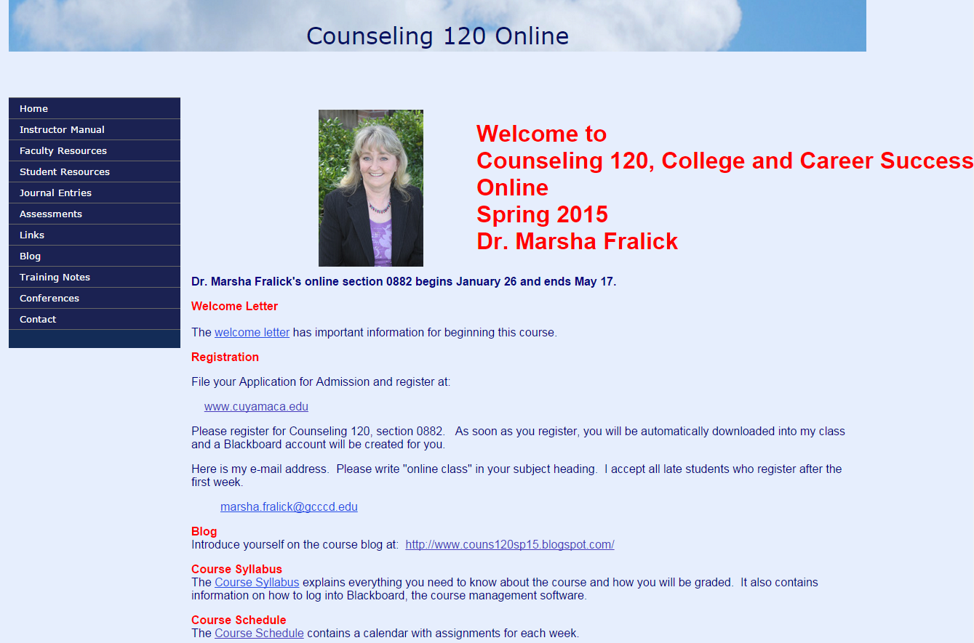

Slide 15
The Blog
Visibility and interaction start before the class begins.
Meet the professor.
Introduce yourself.
Describe your educational journey.
Make a personal connection.

Slide 16
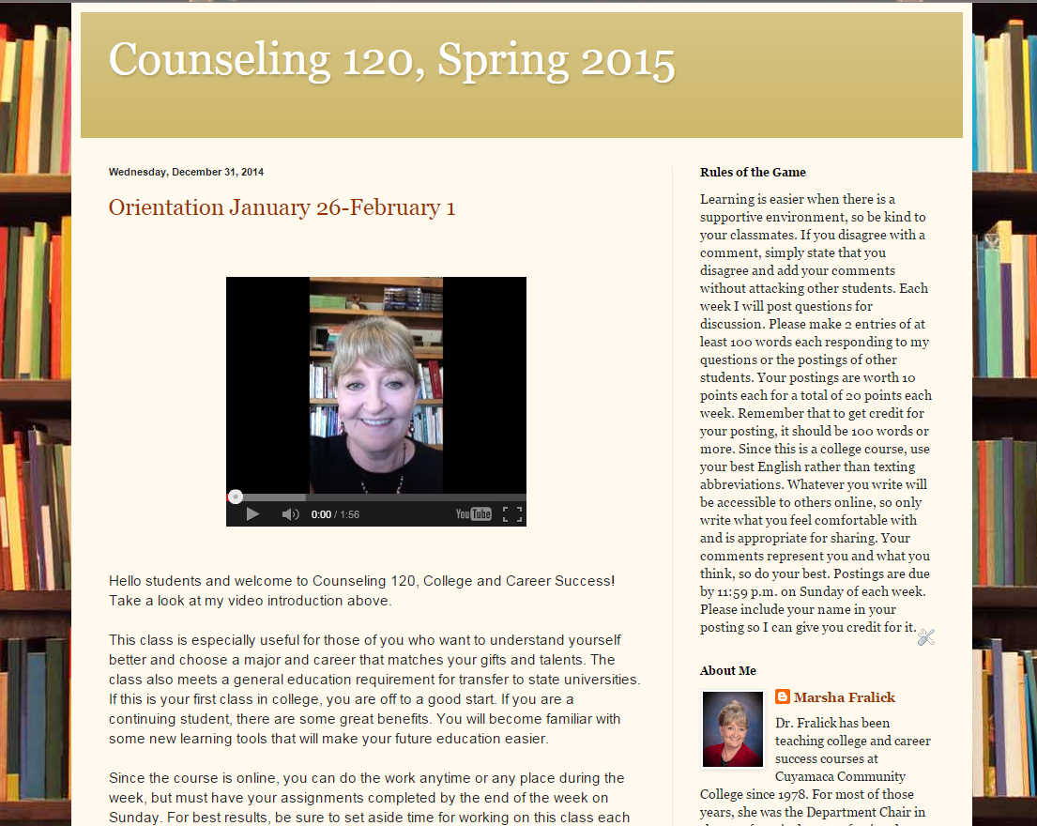

Slide 17
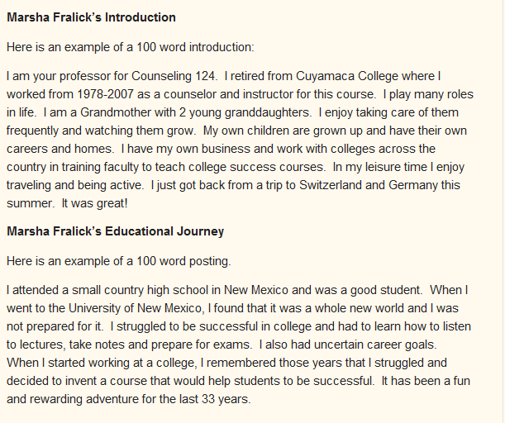

Slide 18
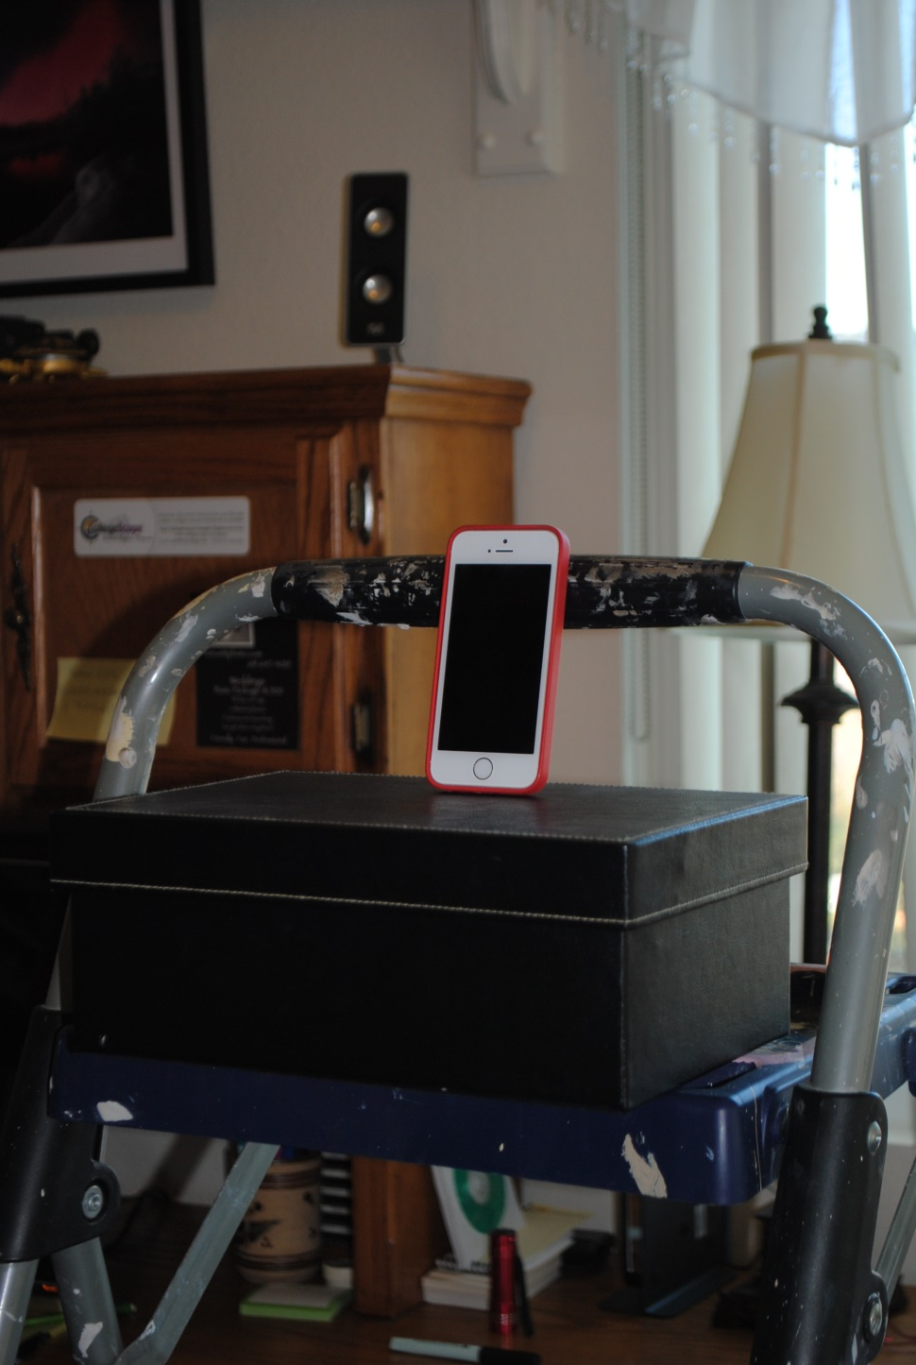
My Recording Studio

Slide 19
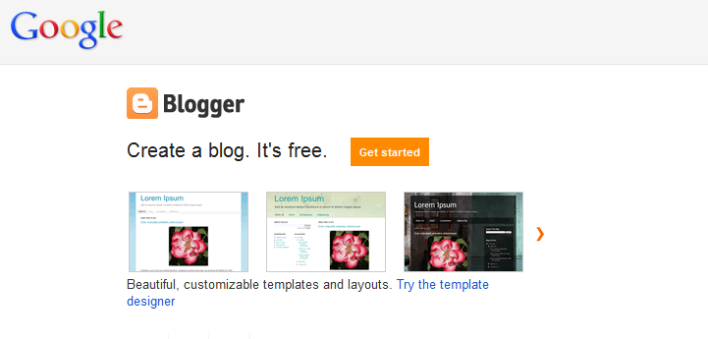
www.blogger.com

Slide 20
Organization
Welcome letter
Calendar
Syllabus
Course Management System
(such as Blackboard)

Slide 21
The Welcome Letter
What is the course about?
Why should you take it?
What are the benefits?
Myths about online courses
Time commitment required
Being an independent online learner
Begin the first week
How you begin the class sets the stage for student involvement and success.

Slide 22
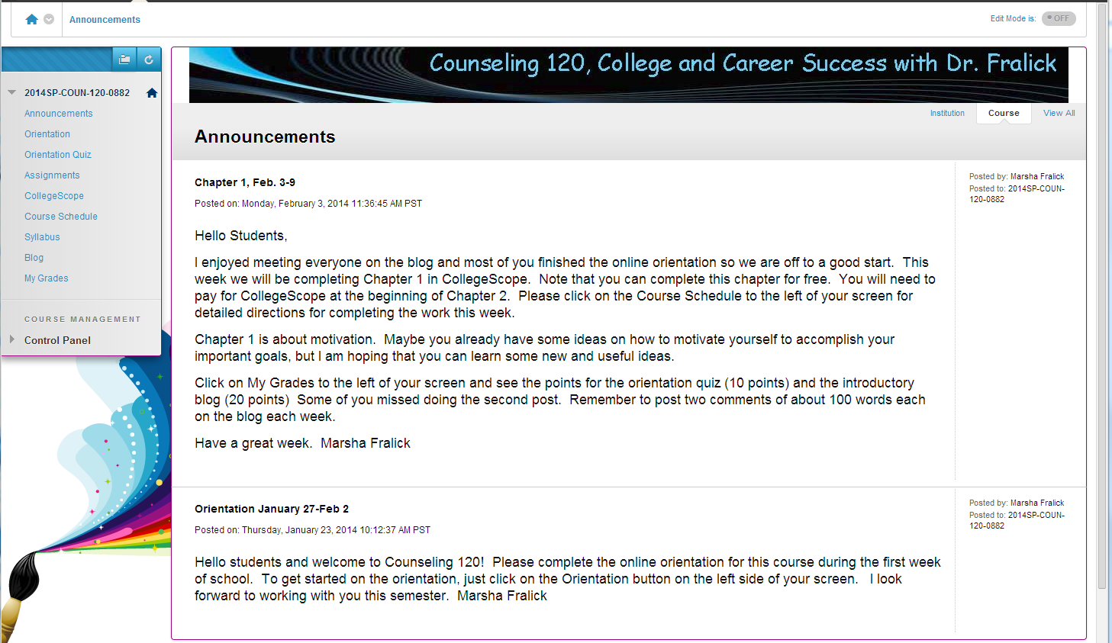

Slide 23
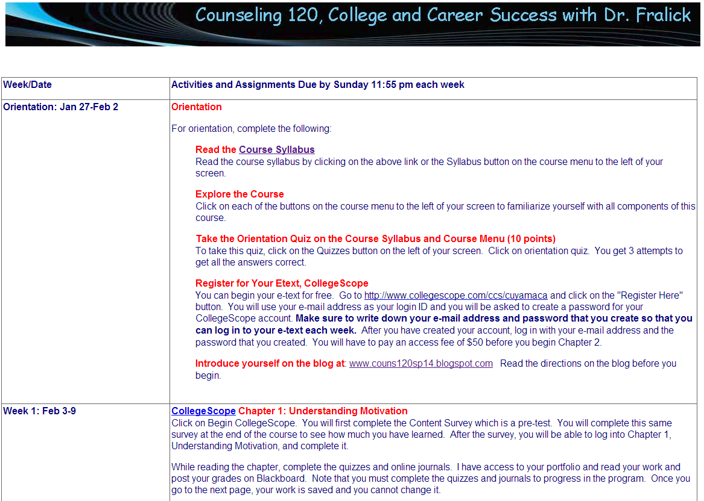

Slide 24
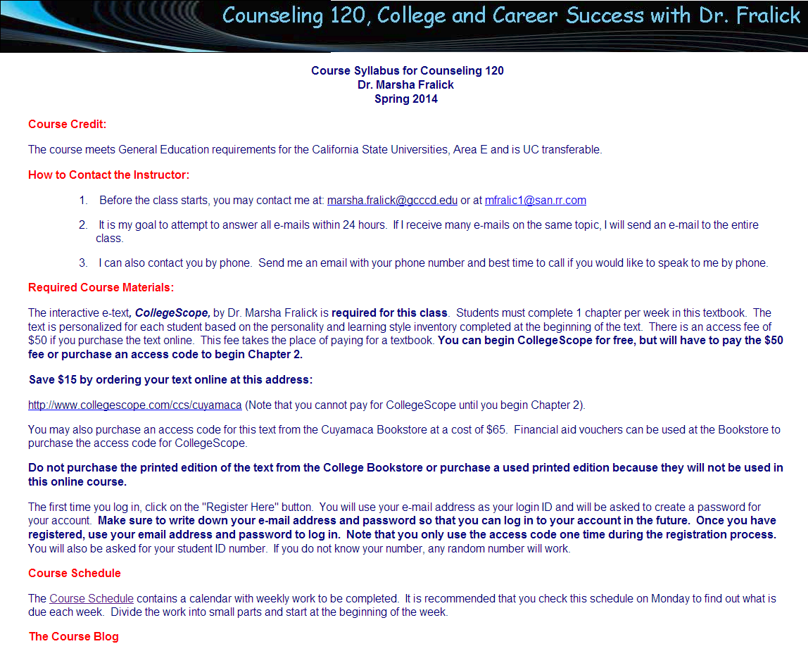

Slide 25
Compassion
The first 2 weeks are critical
Help students get to know one another.
Rules for conduct; be kind to others.
Get to know your students and their individual situations.
Follow up on any missing work.

Slide 26
Analytical
Assignments that encourage creative and critical thinking
Clear expectations
Timely grading of assignments and posting grades
Current grade in course available each week

Slide 27
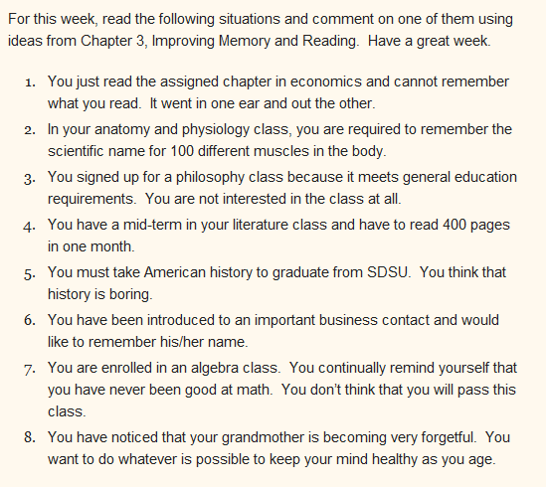

Slide 28
Lead by Example
The professor sets the tone and provides leadership
How you begin is how you will end
  Modeling
  Showing examples

Slide 29
My Online Course https://gcccd.blackboard.com/

Slide 30
See my handout for online resources: how to be a guest in my online course welcome letter syllabus schedule

Slide 31
Quality Online Education
Visible
Organized
Compassionate
Analytical
Lead by example
Interactive!

Slide 32


Slide 33

Best wishes as you help your students to think positively and be successful.
Questions?

